Slide 1
DHRI R Introduction
Dr. Aren Cambre
August 20, 2019

Slide 2
Agenda
Intro/purpose
Install
R and R Studio 101
Chapter 1 of Text Mining with R: “The tidy text format”

Slide 3
…but do this first
Start downloading R and RStudio

Slide 4
Intro/purpose
Brief overview of R and Tidyverse
Interrupt me if you’re confused.

Slide 5
Who am I?
Aren Cambre
Director, Web Application Services Team
Education:
BS Computer Science, ‘99
BA Mathematics, ’99
MS Computer Science, ‘03
DE Engineering Management, ‘14
How I got into data science

Slide 6
Aren’s practical uses of R
Monitoring vital statistics of services
Tracking camp registration progress

Slide 7
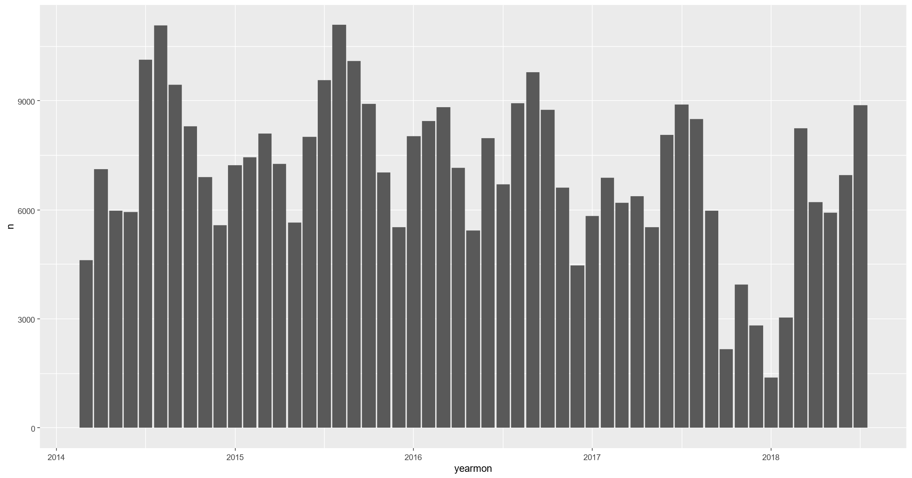
Aren’s practical uses of R

Slide 9
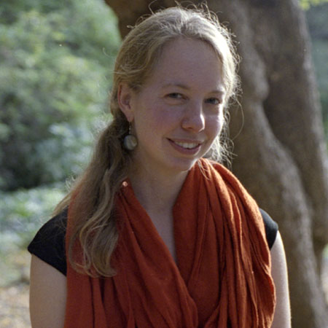
Dr. Jo Guldi’s use of data science
Asst. Professor of History at SMU
Studying the Hansard Corpus

Slide 10
SMU and Data Science
Strategic for SMU

Slide 11
Install
R
R Studio

Slide 12
R
Scripts
Compared to SPSS, SAS, etc.
It’s weird
What is Tidyverse?

Slide 13
Objects
1
"test"
x <- 1
y <- "test"

Slide 14
Function
addnumbers <- function(m, n) {
z <- m + n
print(z)
}

Slide 15
Function return value
addnumbers <- function(x, y) {
z <- x + y
return(z)
}

Slide 16
Library
Collection of functions, data, etc.
Adds to R

Slide 17
Vector
scouts <- c("Sam", "Ethan", "Davian", "Hayes", "Max")

Slide 18
Data frame
scouts <- c("Sam", "Ethan", "Davian", "Hayes", "Max")
ranks <- c("Webelos", "Bear", "Lion", "Bear", "Wolf")
pack <- data.frame(scouts, ranks)

Slide 19
That’s the basics
More basics to be covered as we encounter them

Slide 20
R Studio
IDE
Meaning of windows
Execute
Project

Slide 21
Chapter 1
Switch to textbook and work through examples

